Slide 1
Gaussian Processes and Bayesian Optimization for Automated Experiment
Sergei V. Kalinin

Slide 2
What is A Workflow?
Workflow: ideation, orchestration, implementation
Domain specific language
Dynamic planning: latencies and costs
Reward and value functions
Designed in academia and adopted by industry
Are they optimal?
Can we design them better?
Can they be changed dynamically?

Slide 3
Machine Learning for Automated Experiments
Machine learning is now everywhere…. But sometimes it is difficult to see it in the lab!
Applying ML in experimental sciences can be a very daunting proposition:
Understand the problem
Know (some) ML
Develop code: from prototype to operationalization
Implement on the working instrument
Connect to the cloud
Understand the results
The code base and libraries can change (TF/Keras -> PyTorch -> Jax -> ?)
Basic concepts are often incomprehensible

Slide 4
Machine Learning for Automated Experiments
We are not going to try to learn all aspects of it. ML in domain/experiment is always a teamwork.
The first step is to define your problem – what is that you want to accomplish?
The second step is to define your hyper language – what are the things that you know how to do (or can learn to do)?
The third step is to work backward from your problem and define the workflow in terms of your hyper language. Do you even need machine learning to solve it?
For ML, knowing code is (in some sense) secondary. However, it is critical to understand HOW it works.

Slide 5
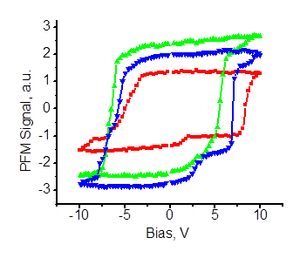
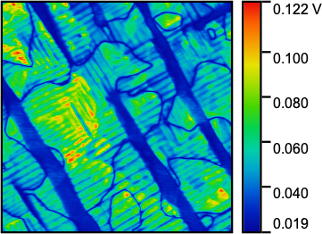
Workflows in Scanning Probe Microscopy
Zoom in
Zoom in
Overview scan
?
Workflow plane
After acquisition
analysis
Minimal instruction set control language
Instrument plane
Initiate spectrum (parameters)
Tune microscope
Initiate scan (parameters)
Position probe (x,y,t)
Stream data

Slide 6
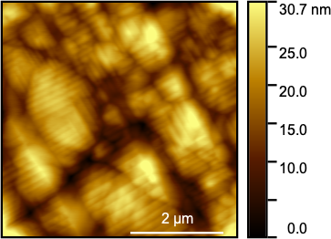
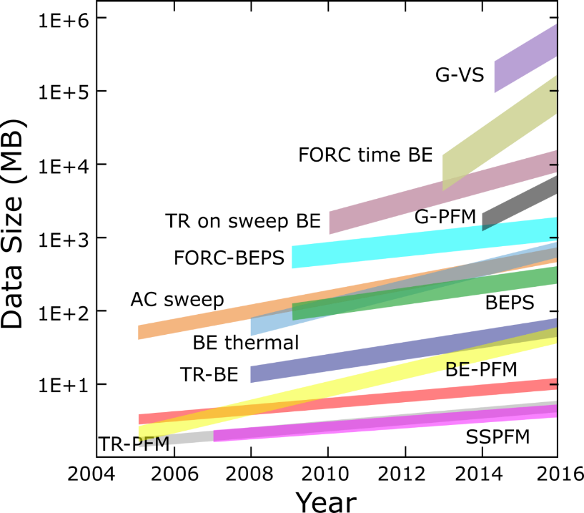
Single step workflow
Topography [nm]
Amplitude [V]
Interesting functionalities are expected at the certain elements of domain structure
We can guess some; we have to discover others
Can we run experiment so that we either explore
only selected regions,
discover new functionalities, or
seek functionalities we want?

Slide 7
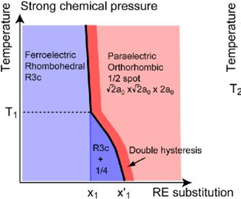
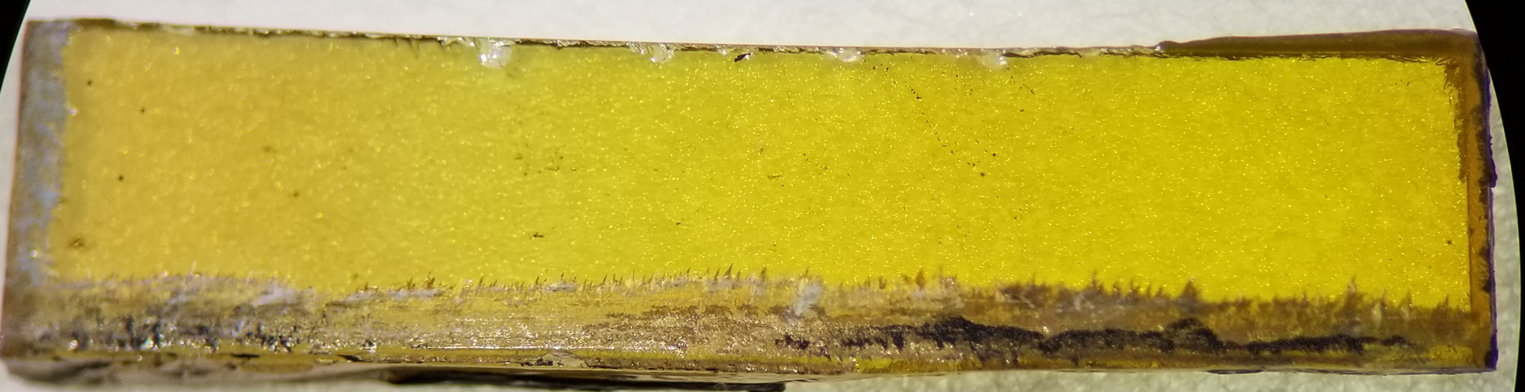
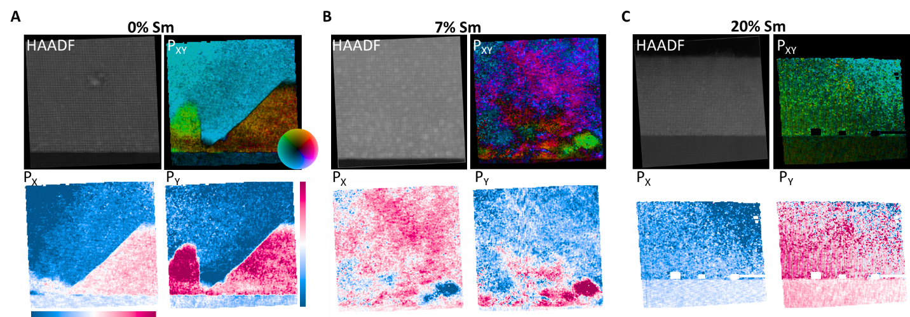
Combinatorial library
Sample by I. Takeuchi, UMD
Phase diagram by N. Valanoor et al.
1
~5
7
1
2
3
4
5
6
7
20%Sm BiFeO₃
Linear est. 7%Sm BiFeO₃
BiFeO₃
arXiv:2004.11817

Slide 8
Automated Experiment: … with John Snow priors…

Slide 9
What do we know if we do not know anything?

Slide 10
What do we know if we do not know anything?

Slide 11
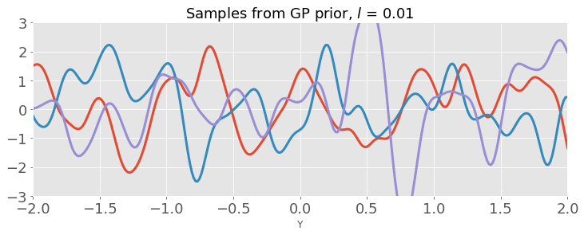
Gaussian Process Regression
Covariance matrix determines what type of functions we will allow.
$$k\left(x,x^{′}\right)= exp\left(−\frac{1}{2l}{\left(x−x′\right)}^{2}\right)$$

Slide 12
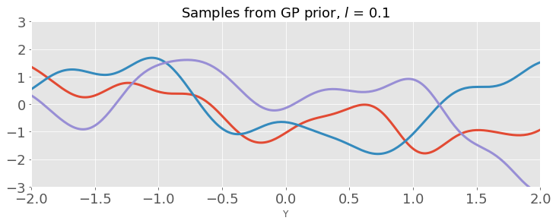
Gaussian Process Regression
Covariance matrix determines what type of functions we will allow.
$$k\left(x,x^{′}\right)= exp\left(−\frac{1}{2l}{\left(x−x′\right)}^{2}\right)$$

Slide 13
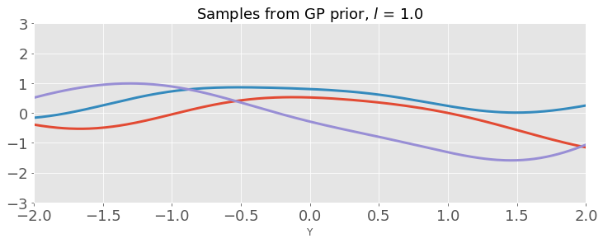
Gaussian Process Regression
Covariance matrix (kernel) determines what type of functions we will allow.
$$k\left(x,x^{′}\right)= exp\left(−\frac{1}{2l}{\left(x−x′\right)}^{2}\right)$$
L controls the length scale – sort of how far points should be to make them independent of each other.

Slide 14
What have we learned from Part 1:
Gaussian Process
Kernel and kernel parameters
Kernel Priors
Noise Priors
Posteriors

Slide 15
What will we learn in part 2:
Bayesian Optimization
Bayesian Optimization based on Gaussian Process
Acquisition Functions

Slide 16
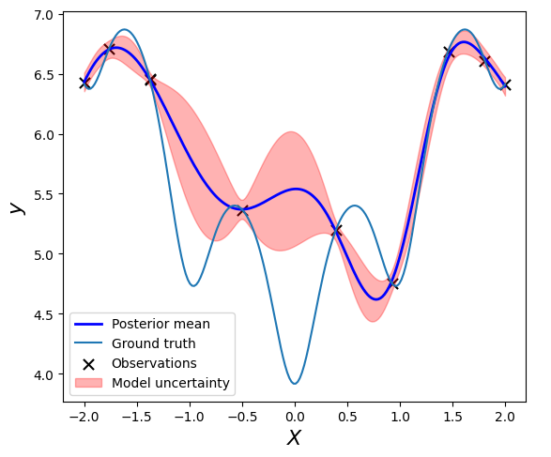

Slide 17
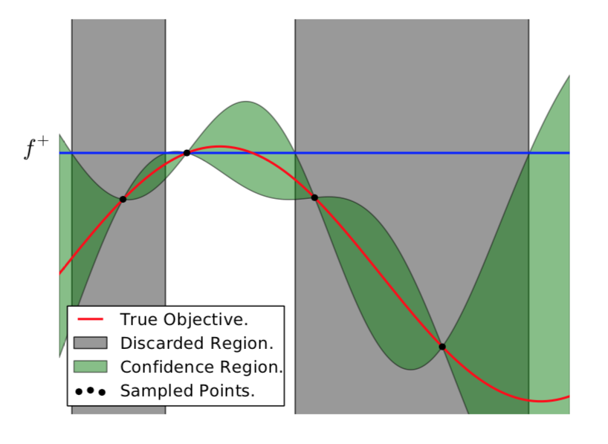
Bayesian Optimization
We have some measurements in space X, and we want to maximize some property f(X).
How can we decide what point to measure next to best maximize f?
We need to balance the exploration of the space with exploitation of regions near we have already know
N. de Freitas et al., Taking the Human Out of the Loop: A Review of Bayesian Optimization , Proceedings of the IEEE 104, 148 (2015)

Slide 18
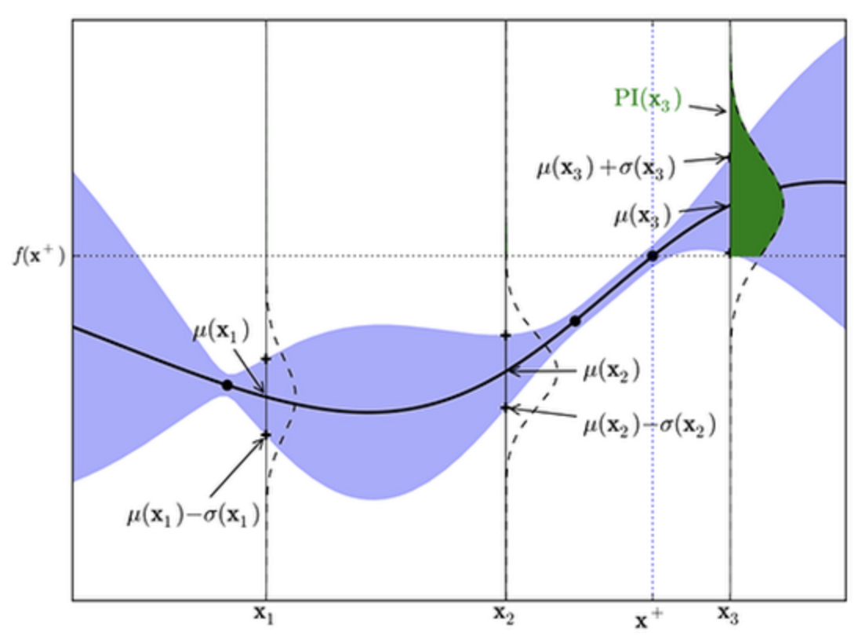
Acquisition Functions
Upper confidence bound: simplest possible - just take the upper confidence bound from the prediction
Probability of Improvement: Integral from current functional maximum to upper limit of distribution as test point
Expected Improvement: Instead of probability of improvement, we want to maximize the expected increase in the function value
There are (always) more…
Probability of Improvement
Acquisition Function

Slide 19
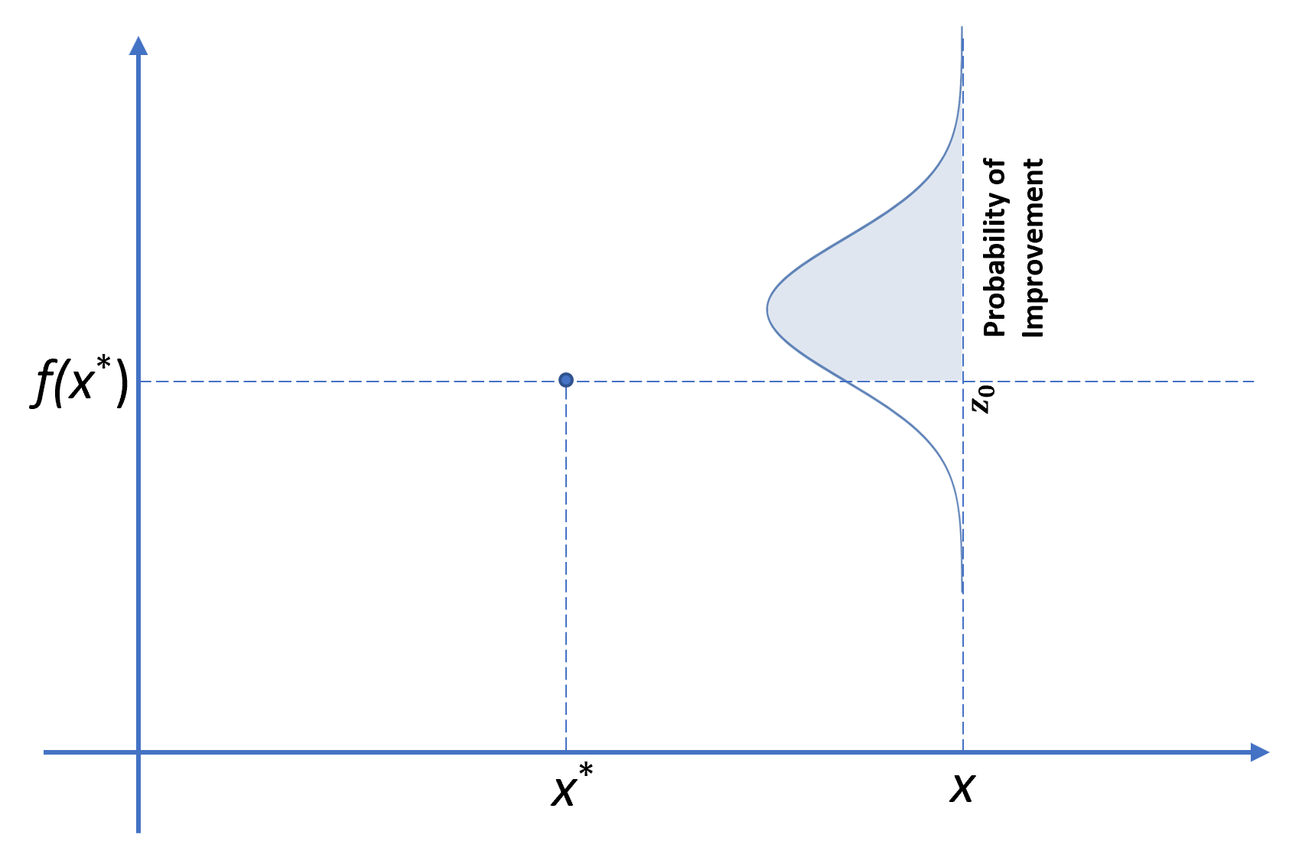
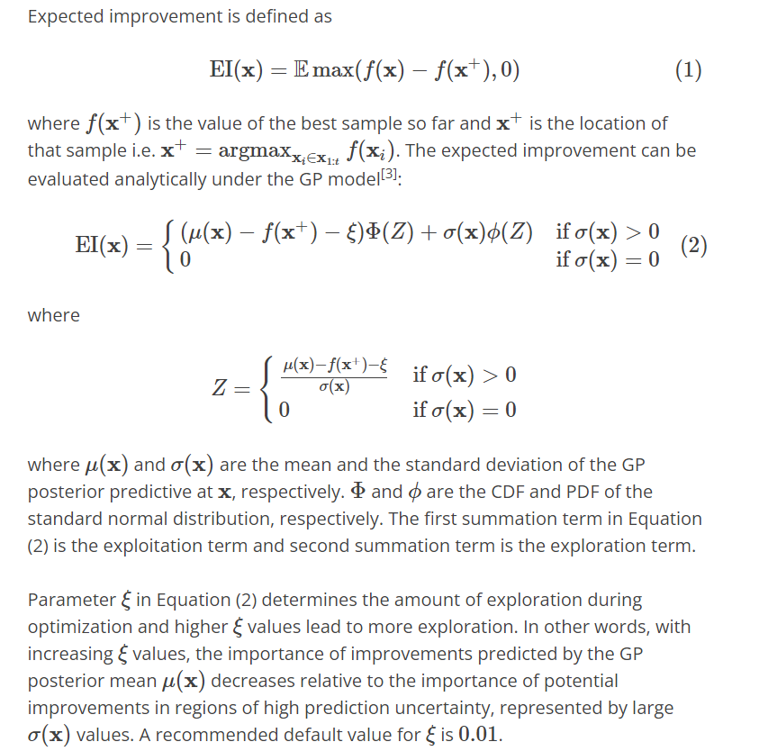

Slide 20
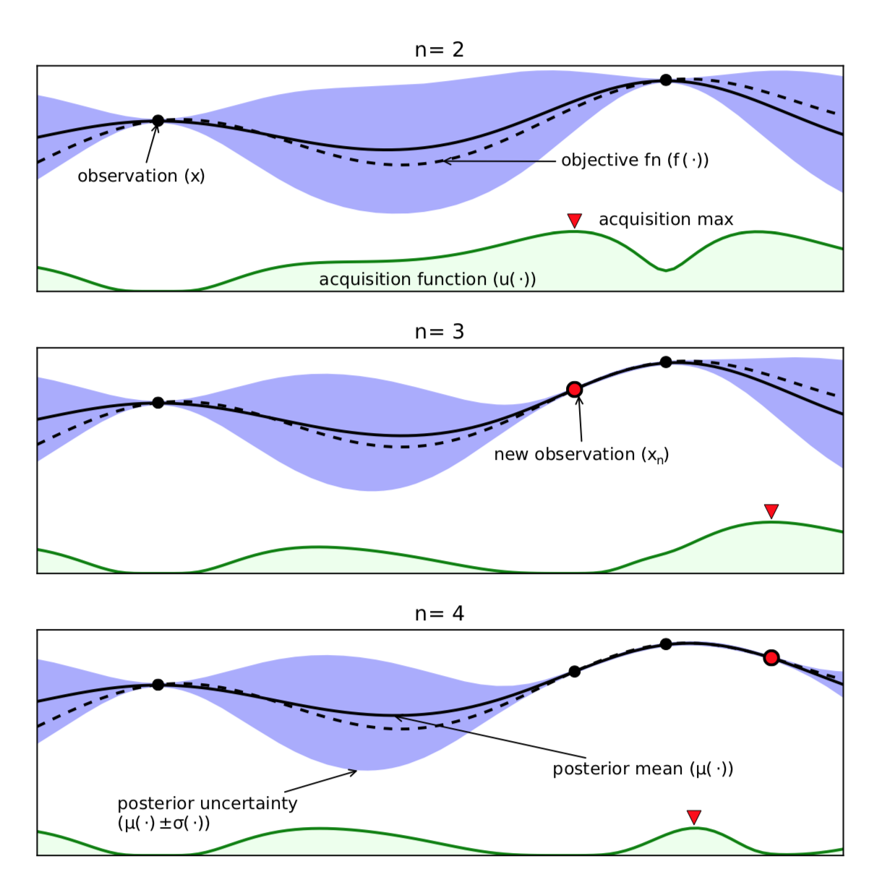
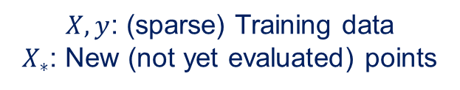
The basics: Bayesian Optimization
$X,y$: (sparse) Training data
$X_{∗}$: New (not yet evaluated) points
Obtain/update
training data D
Train surrogate model
$$X→y$$
Evaluate new point
$$X_{∗}^{i}=argmax(acq)$$
Make prediction
$X_{∗}→\overline{f_{∗}}$, $𝕍\left[f_{∗}\right]$
Acquisition function
$acq(\overline{f_{∗}}$, $𝕍\left[f_{∗}\right])$
N. de Freitas et al., Taking the Human Out of the Loop: A Review of Bayesian Optimization , Proceedings of the IEEE 104, 148 (2015)

Slide 21
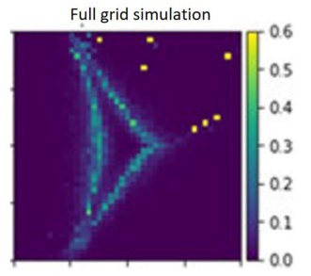
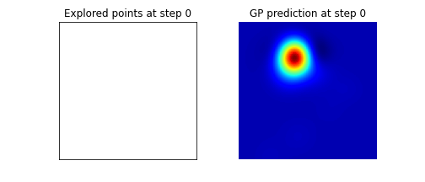
Bayesian Optimization for physical discovery
Discovering regions where heat capacity is maximized in NNN Ising model
Js
Jc

